Slide 1
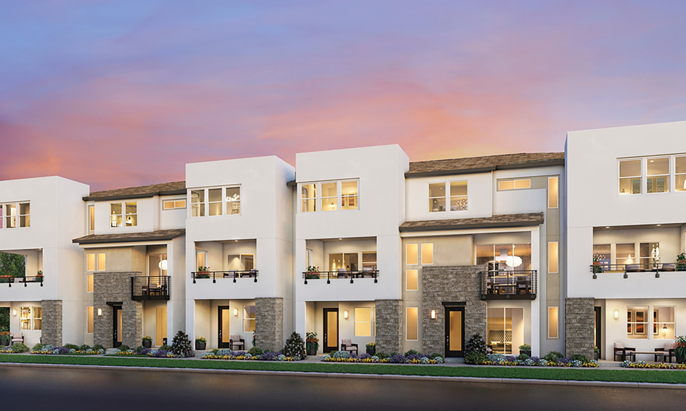
Everly at Civita
E1X
HOME SITE 2404 | 2750 EVERLY DR | San Diego, CA 92108

Slide 2
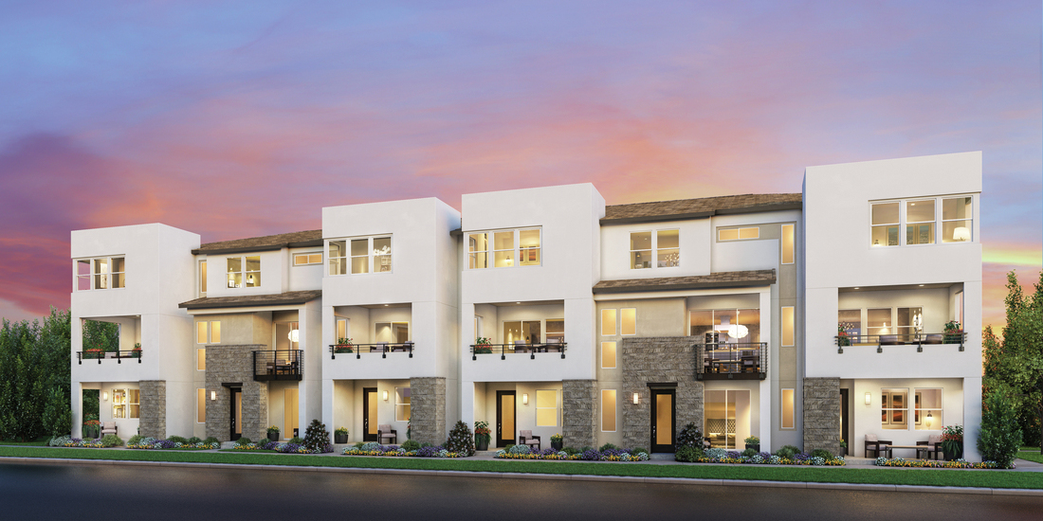







Designer Appointed Features | EXTERIOR selections
1 |  | Stucco 1
 |  | Soothing White SW 6539
2 |  | Stucco 2
 |  | Prospect SW 9615
3 |  | Front door
 |  | Rojo Marron SW 9182
4 |  | Garage door
 |  | Polished Mahogany SW 2838
5 |  | Fascia trim
 |  | Polished Mahogany SW 2838
6 |  | Window
 |  | Colonnade Gray SW 7641
7 |  | railings
 |  | Tricorn Black SW 6258
8 |  | Lap siding
 |  | Timber Bark

Slide 3
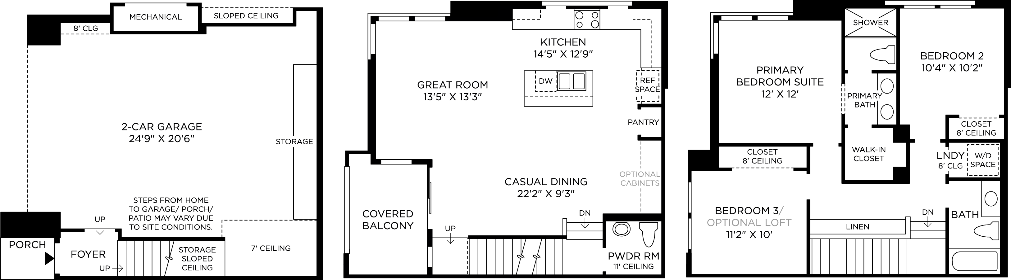
Designer Appointed Features | STRUCTURAL OPTIONS

Slide 4

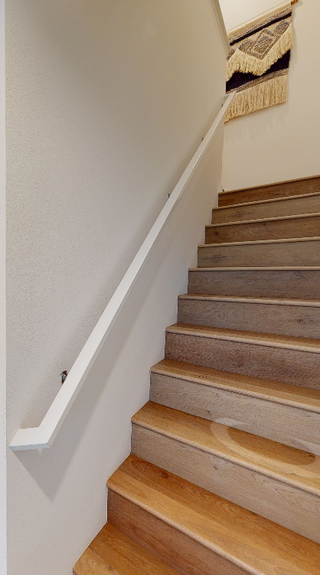
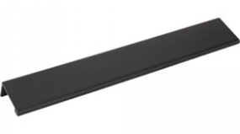
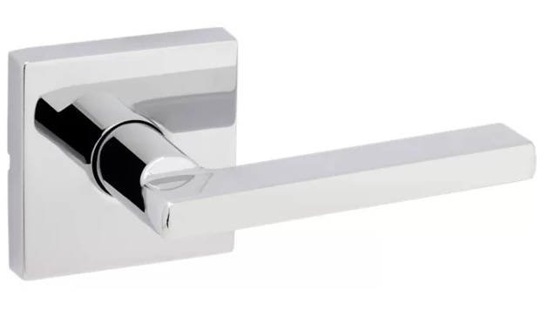

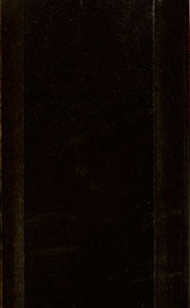

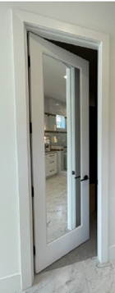



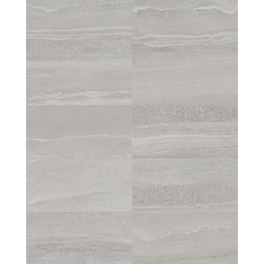
Designer Appointed Features | INTERIOR SELECTIONS
1 | CABINETS – whole house
 | Slab Style Door White | Acrylic
2 | Cabinet HARDWARE
 | Pull Tabs on Doors & Drawers Matte Black | A500-10MB & A500-125MB
3 | STAIR SYSTEM
 | Included Stairs Espresso
4 | INTERIOR DOOR HANDLES
 | Kwikset Halifax Chrome | Lever Square Rosette
5 | INTERIOR DOORS
 | Flat Slab Solid Core White | Solid Core
6 | PRIMARY CLOSET DOOR
 | Dual Sided Mirrored Door White
7 | Interior paint
 | Sherwin Williams Pure White | SW 7005
8 | FLOORING – carpet
 | Shaw TB Expert Design Scotch Mist
9 | FLOORING – LVP
 | Mohawk Harrington Crest Dove
10 | FLOORING – TILE
 | Arizona Tile Davenport Ash | 16 x 32 Matte Porcelain
1
2
3
4
5
6
7
8
9
10

Slide 5
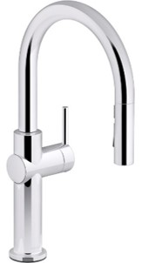
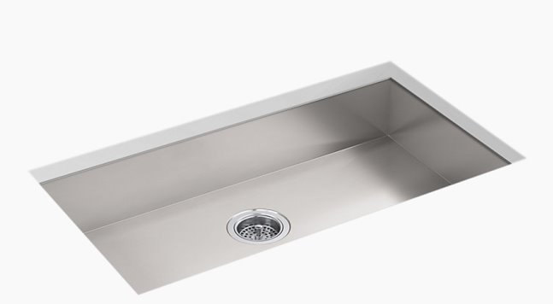
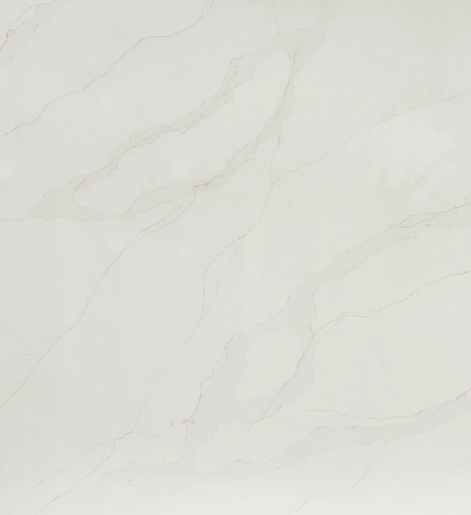
Designer Appointed Features | KITCHEN
1 | FAUCET
 | Kohler Crue Polished Chrome | Touchless Pull Down
2 | SINK
 | Kohler Vault Stainless Steel | Single Bowl
3 | COUNTERTOP–Waterfall ISLAND
 | Arizona Tile Quartz Maxim | 2-1/4” Miter Edge
4 | COUNTERTOP–PERIMETER
 | Arizona Tile Quartz Maxim | 2-1/4” Miter Edge
5 | Countertop - BACKSPLASH
 | Arizona Tile Quartz Maxim | Full Height
1
2
3
4
5

Slide 6
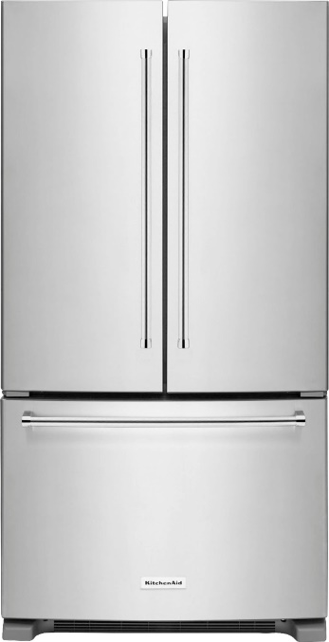
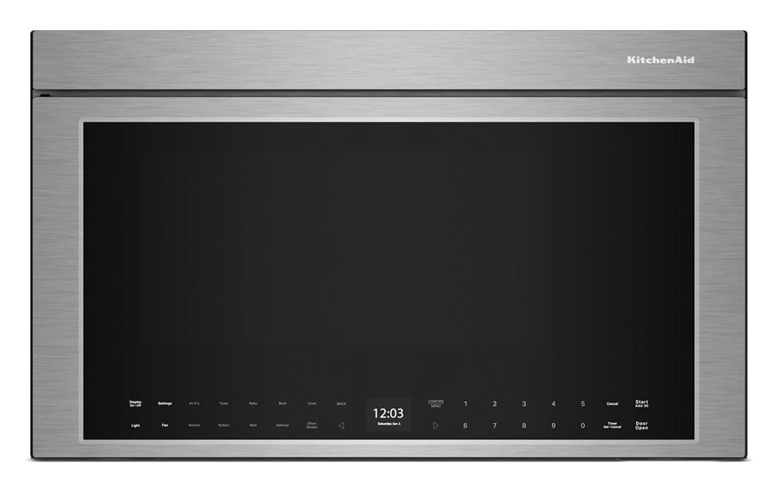
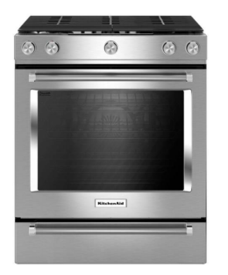
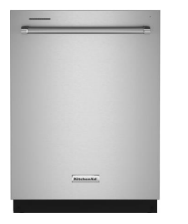
Designer Appointed Features | KITCHEN APPLIANCES
1 | REFRIGERATOR
 | KitchenAid French Door Stainless Steel | 36” Freestanding
2 | Microwave/VENT HOOD
 | KitchenAid Stainless Steel | 30” Hood Combo
3 | Dishwasher
 | KitchenAid Stainless Steel | Hidden Controls
4 | Range
 | KitchenAid Stainless Steel | 30” Gas Range
1
2
3
4

Slide 7
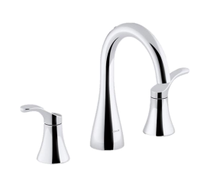
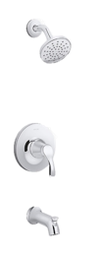
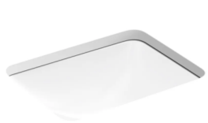
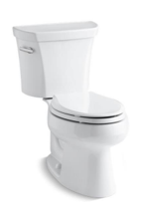
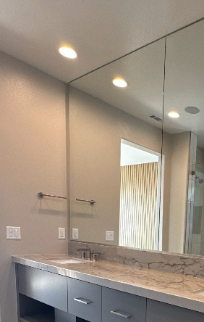
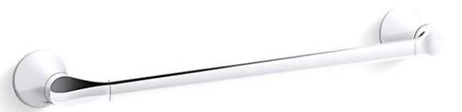
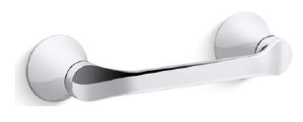

Designer Appointed Features | HALL BATH 3RD FLOOR
1 | FAUCET
 | Kohler Simplice Polished Chrome | Widespread
2 | SINK
 | Kohler Caxton Rectangle Undermount
3 | Tub SHOWER FIXTURES
 | Kohler Simplice Polished Chrome
4 | TOILET
 | Kohler Wellworth Standard Height | Quiet Close Seat
5 | BATH HARDWARE
 | Kohler Simplice Polished Chrome | Towel Bar & Toilet Paper Holder
6 | MIRROR
 | Full Height To Ceiling max 10’
7 | COUNTERTOP
 | Arizona Tile Quartz Maxim | 1-1/2” Miter Edge
8 | TUB SHOWER WALL TILE
 | Arizona Tile Glam White | 2.5” x 9” Matte Porcelain
1
2
3
4
5
6
7
8

Slide 8
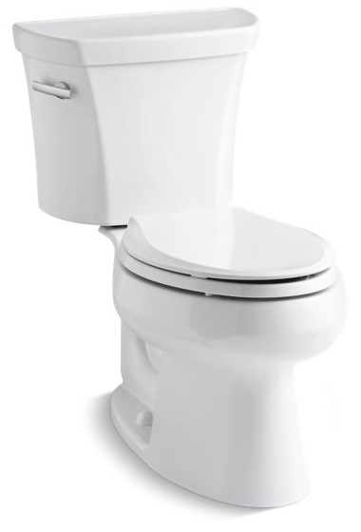
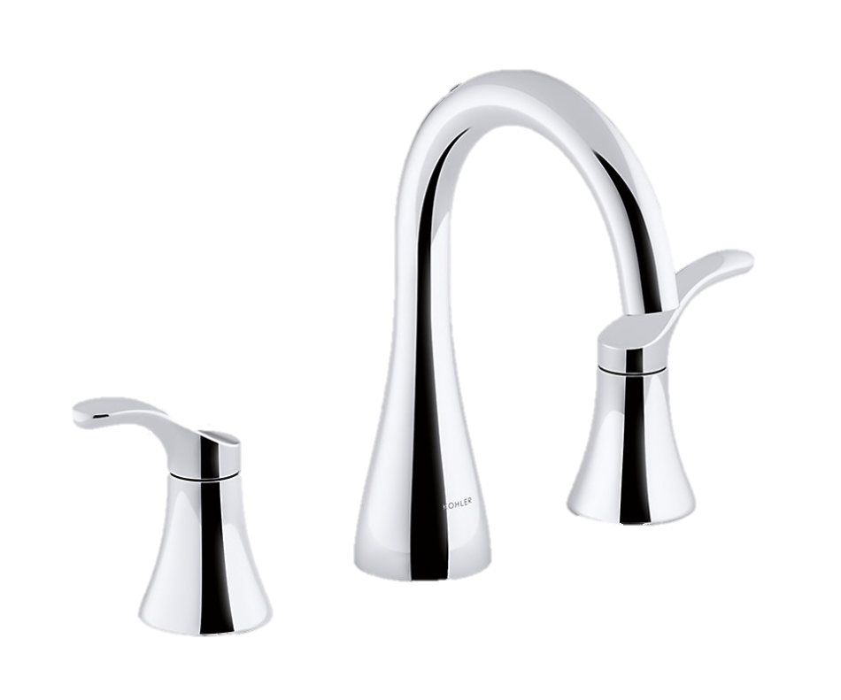
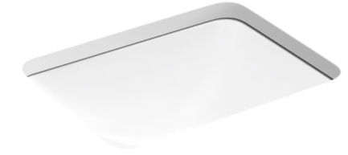
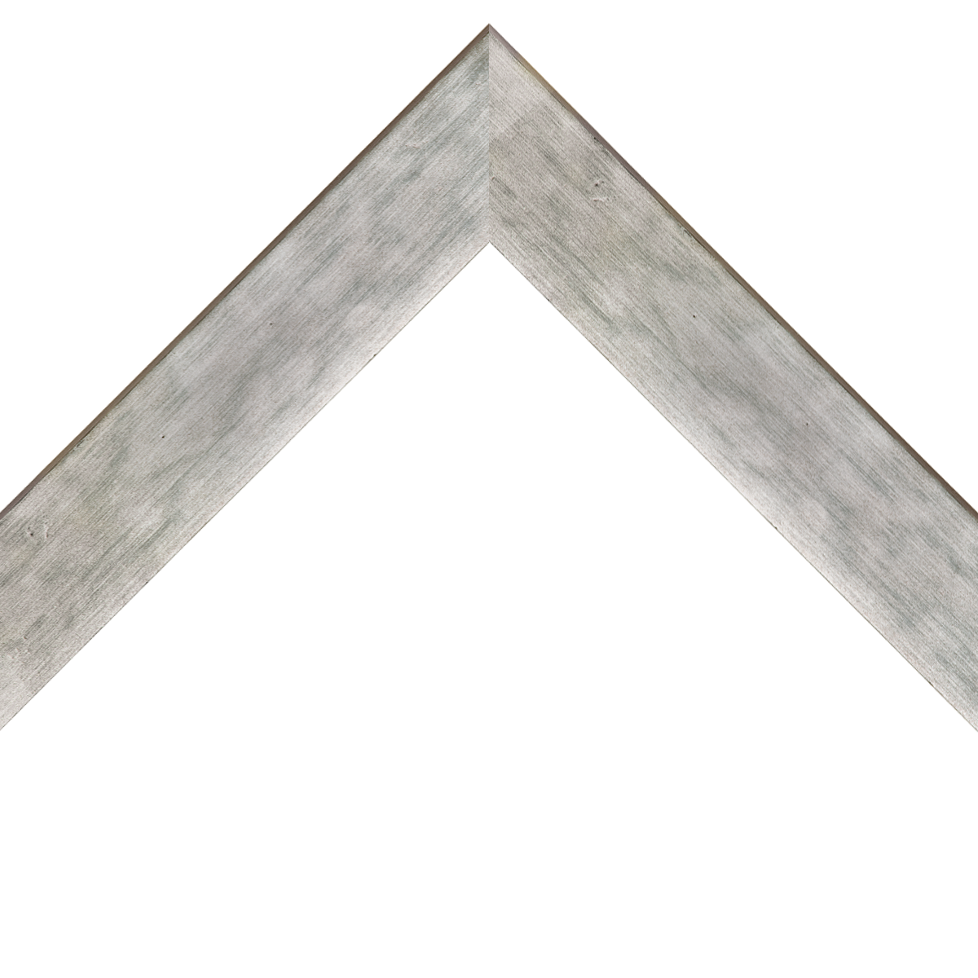
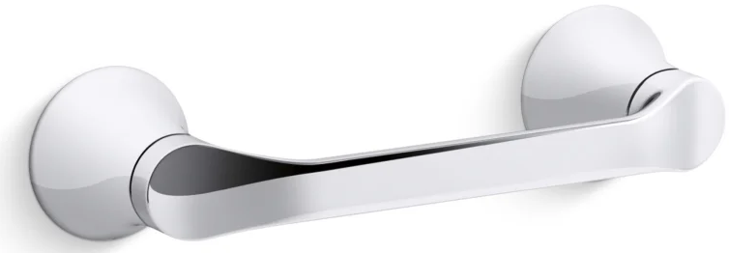
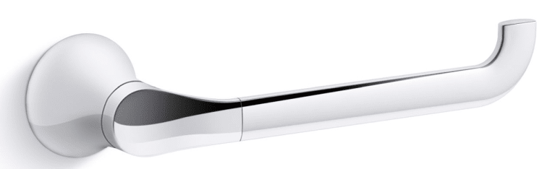
Designer Appointed Features | POWDER ROOM
1 | FAUCET
 | Kohler Simplice Polished Chrome | Widespread
2 | SINK
 | Kohler Caxton Rectangle Undermount
3 | TOILET
 | Kohler Wellworth Standard Height | Quiet Close Seat
4 | BATH HARDWARE
 | Kohler Simplice Polished Chrome | Towel Arm & Toilet Paper Holder
5 | FRAMED MIRROR
 | Era Silver
6 | COUNTERTOP
 | Arizona Tile Quartz Maxim | 1-1/2” Miter Edge
1
2
3
4
5
6

Slide 9
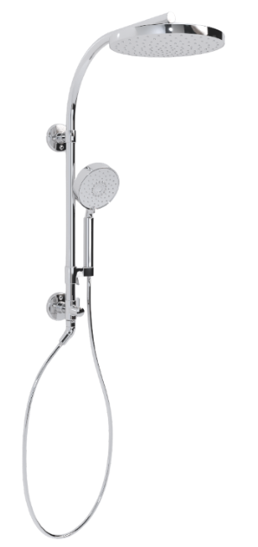
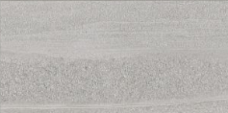


Designer Appointed Features | PRIMARY BATHROOM
1 | FAUCET
 | Kohler Simplice Polished Chrome | Widespread
2 | SINK
 | Kohler Caxton Rectangle Undermount
3 | SHOWER FIXTURE
 | Kohler Hydrorail Column Polished Chrome | Awaken Rainhead
4 | TOILET
 | Kohler Wellworth Standard Height | Quiet Close Seat
5 | BATH HARDWARE
 | Kohler Simplice Polished Chrome | Towel Arm & Toilet Paper Holder
6 | MIRROR
 | Full Height To Ceiling max 10’
7 | COUNTERTOP
 | Arizona Tile Quartz Maxim | 1-1/2” Miter Edge
8 | SHOWER WALLS TILE
 | Arizona Tile Davenport 16 x 32 Ash | Back Wall
 | Daltile Fabric Art Linear 12 x 24 White Matte | Side Walls
9 | SHOWER FLOOR TILE
 | Daltile Fabric Art Textile Stack White | 1 x 3
1
2
3
4
5
6
7
8
9

Slide 10
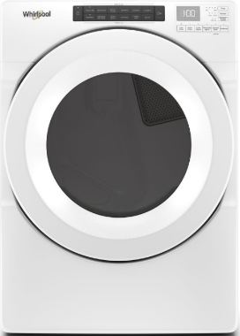
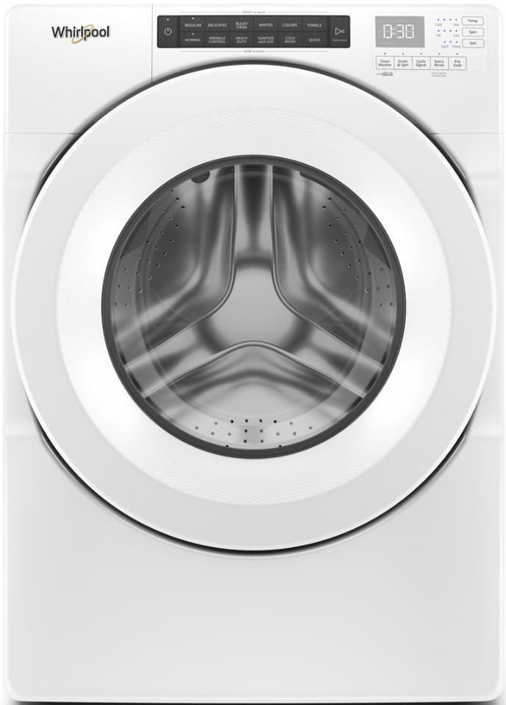
Designer Appointed Features | LAUNDRY
1 | WASHER/DRYER
 | Whirlpool Washer Dryer White | Stacked
1

